Slide 1
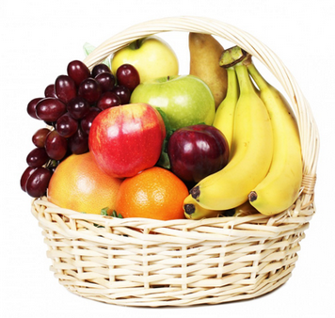
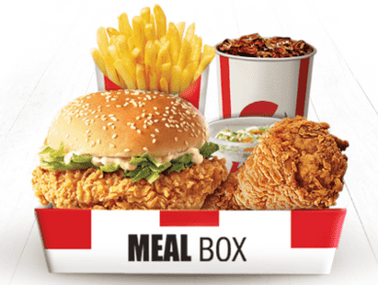
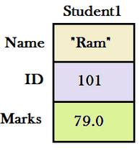
Structures
Week 13
Sumaiyah Zahid

Slide 2

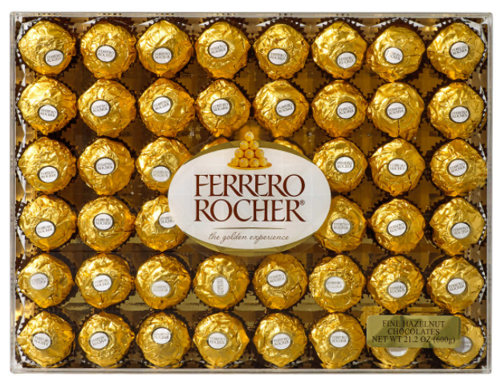
Arrays VS Structures
Array stores multiple data of the same data type under the same name.
Structures store multiple data of different data type under the same name and it can be customized.

Slide 3
Practice Question
Make a c program to store roll number of 5 students in year, city, roll_num variables.
batch = 21
city = k
roll_num = 4325

Slide 4
#include <stdio.h>
int main()
{
int batch[5],i;
char city[5];
int roll_num[5];
for(i=0; i<5; i++)
{
printf("Enter your batch");
scanf("%d", &batch[i]);
printf("Enter your city initial");
scanf("%c", &city[i]);
printf("Enter your roll_number");
scanf("%d", &roll_num[i]);
}
return 0;
}

Slide 5
Structures
This step is customizing:
i.e. “Defining your own data type”.
struct fast_roll_num
{
int batch;
char city;
int roll_num;
};
INT | INT | INT | INT | CHAR | INT | INT | INT | INT

Slide 6
Structures
INT | INT | INT | INT | CHAR | INT | INT | INT | INT
struct fast_roll_num student1; // Declaration
student1.batch=21; // Initialization
student1.city=’k’;
student1.roll_num=2493;
struct fast_roll_num student2={21,’k’,2493}; // Declaration & Initialization

Slide 7
Structures
INT | INT | INT | INT | CHAR | INT | INT | INT | INT
Batch, city & roll_num are known as Members.
(.) operator is known as Member Access Operator.
struct fast_roll_num student1;
student1.batch=21;
student1.city='k';
student1.roll_num=2493;
printf (“%d”, sizeof(fast_roll_num)); // What’s the output?

Slide 8
#include <stdio.h>
struct fast_roll_num
{
int batch;
char city;
int roll_num;
};
int main()
{
struct fast_roll_num student1;
student1.batch=21;
student1.city='k';
student1.roll_num=2493;
struct fast_roll_num student2={21,'k',2493};
return 0;
}

Slide 9
Practice Question
Make a c program to record data of students which includes their name, marks and roll number.
name = ”Sumaiyah”
marks = 45.7
batch = 21
city = k
roll_num = 2493

Slide 10
#include <stdio.h>
struct student
{
char name[20]; float marks; int batch; char city; int roll_num;
};
int main()
{
struct student student1;
printf("Enter your name :"); scanf("%s", student1.name);
printf("Enter your marks:"); scanf("%f", &student1.marks);
printf("Enter your batch:"); scanf("%d", &student1.batch);
printf("Enter your city:"); scanf(" %c",&student1.city);
printf("Enter your roll_num:"); scanf("%d", &student1.roll_num);
printf("Your data is\nName : %s \nMarks : %f\nBatch : %d\nCity:%c\nRoll Number :%d", student1.name, student1.marks, student1.batch, student1.city, student1.roll_num);
return 0;
}

Slide 11
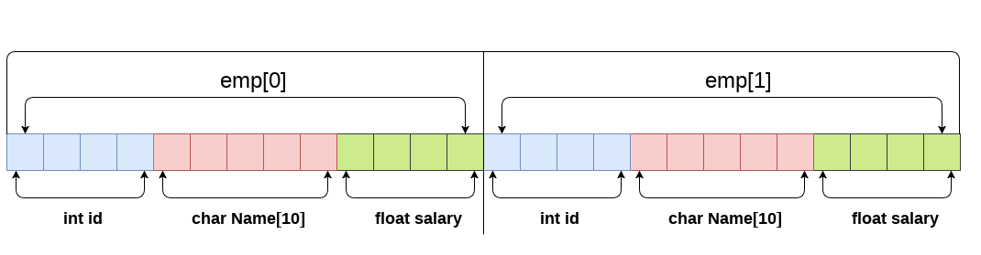
Array Of Structures
struct student
{
char name[20];
float marks;
int batch;
char city;
int roll_num;
};
struct student sectionA[5];

Slide 12
Practice Question
Make a c program to record data of 10 students which includes their name, marks and roll number.
name = ”Sumaiyah”
marks = 45.7
batch = 21
city = k
roll_num = 2493

Slide 13
#include <stdio.h>
struct student
{
char name[20]; float marks; int batch; char city; int roll_num;
};
int main()
{
int i;
struct student sectionA[10];
for(i=0; i<10; i++) {
printf("Enter your name :"); scanf("%s", sectionA[i].name);
printf("Enter your marks:"); scanf("%f", &sectionA[i].marks);
printf("Enter your batch:"); scanf("%d", &sectionA[i].batch);
printf("Enter your city:"); scanf(" %c",&sectionA[i].city);
printf("Enter your roll_num:"); scanf("%d", &sectionA[i].roll_num);
}
return 0;
}

Slide 14
Practice Question
Make a c program to record date in a structure having the following format:
day = 1
month = “December”
year = 2021

Slide 15
#include <stdio.h>
struct date
{
int day; char month[10]; int year;
};
int main()
{
int i;
struct date birthday;
printf("Enter your birth day:"); scanf("%d", &birthday.day);
printf("Enter your birth month:"); scanf("%s", birthday.month);
printf("Enter your birth year:"); scanf("%d", &birthday.year);
return 0;
}

Slide 16
Structures
Struct variables may be declared at the same time the struct is defined.
struct date
{
int day;
char month[10];
int year;
} birthday, college_joining_date;

Slide 17
Structures
typedef struct is used to write concise code.
typedef struct date
{
int day; char month[10]; int year;
} date; // this is renamed variable
Instead of struct date birthday you can write date birthday;

Slide 18
Structures
One struct value can be assigned to another by just using =
typedef struct date
{
int day; char month[10]; int year;
} date ;
date college_last_date={10,’May’,2021};
date university_joining_date = college_last_date;

Slide 19
Nested Structures
A struct can contain another struct as well.
struct date
{ int day; char month[10]; int year; } ;
struct student
{
char name[20]; float marks; int batch; char city;
int roll_num; struct date birthday;
};

Slide 20
#include <stdio.h>
struct date
{
int day;
char month[10];
int year;
};
struct student
{
char name[20];
float marks;
int batch;
char city;
int roll_num;
struct date birthday;
};

Slide 21
int main()
{
int i;
struct student sectionA[10];
for(i=0; i<10; i++) {
printf("Enter your name :"); scanf("%s", sectionA[i].name);
printf("Enter your marks:"); scanf("%f", &sectionA[i].marks);
printf("Enter your batch:"); scanf("%d", &sectionA[i].batch);
printf("Enter your city:"); scanf(" %c",&sectionA[i].city);
printf("Enter your roll_num:"); scanf("%d", &sectionA[i].roll_num);
printf("Enter your birth day:");
scanf("%d", &sectionA[i].birthday.day);
printf("Enter your birth month:");
scanf("%s", sectionA[i].birthday.month);
printf("Enter your birth year:");
scanf("%d", &sectionA[i].birthday.year);
}
return 0;
}

Slide 22
Practice Questions
Create a structure called library to hold accession number,
title of the book, author name, price of the book, and flag
indicating whether book is issued or not.
Author Name should be another structure which holds author first name, middle name and last name separately.

Slide 23
Practice Questions
Make a program to display all students whose birthday is in January.
Make a program to display name of students who have marks greater than 50.
Display the count of students who are enrolled in Karachi campus.

Slide 24
Home Assignment
Create a structure to specify data of customers in a bank. The data to be stored is: Account number, Name, Balance in account. Assume maximum of 200 customers in the bank.
A record contains name of cricketer, his age, number of test matches that he has played and the average runs that he has scored in each test match. Create an array of structure to hold records of 20 such cricketer and then write a program to read these records and arrange them in ascending order by average runs.

Slide 25
Passing Structure to Function
void function( struct date a);
function( birthday);
Notes:
kkkkkkk

Slide 26
#include <stdio.h>
struct date
{
int day; char month[10]; int year;
};
void display( struct date a)
{
printf("Your birth-day is on %d %s %d", a.day, a.month, a.year); }
int main()
{
int i;
struct date birthday;
printf("Enter your birth day:"); scanf("%d", &birthday.day);
printf("Enter your birth month:"); scanf("%s", birthday.month);
printf("Enter your birth year:"); scanf("%d", &birthday.year);
display(birthday);
return 0;
}

Slide 27
Returning Structure From a Function
struct date function();
function();
Notes:
kkkkkkk

Slide 28
#include <stdio.h>
struct date
{
int day; char month[10]; int year;
};
struct date get_data()
{
struct date local;
printf("Enter your birth day:"); scanf("%d", &local.day);
printf("Enter your birth month:"); scanf("%s", local.month);
printf("Enter your birth year:"); scanf("%d", &local.year);
return local;
}
int main()
{
struct date birthday;
birthday=get_data();
printf("Your birth-day is on %d %s %d", birthday.day, birthday.month, birthday.year);
return 0; }

Slide 29
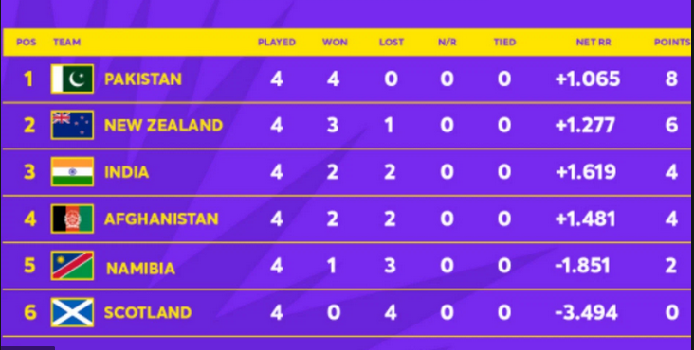
Structures

Slide 30
Structures
struct T20
{ int position;
char country[20];
int played;
int won;
int lost;
float netRR;
int points;
};

Slide 31
struct T20 group2[6]= { {1, "Pakistan",4,4,0,1.065,8},
{2, "NewZealand",4,3,1,1.277,6},
{3, "India",4,2,2,1.619,4},
{4, "Afghanistan",4,2,2,1.481,4},
{5, "Namibia",4,1,3,-1.851,2},
{6, "Scotland",4,0,4,-3.494,0}
};

Slide 32
Structures
Make a program to display all team names who have won at least 2 matches.

Slide 33
Structures
Make a function to display all team names who have won at least 2 matches and their run rate is greater than 1.5.
void func( struct T20 a[]) // Function Definition
{
……
}
func(group2); // Function Call

Slide 34
Structures
Make a function to return count of teams who have lost at least 2 matches.
void func( struct T20 a[]) // Function Definition
{
……
return count;
}
a=func(group2); // Function Call

Slide 35
Structures & Pointers

Slide 36
Struct pointer
struct student {
char name[20]; float marks;int batch; char city; int roll_num; };
struct student *ptr, student1;
ptr=&student1;
(*ptr).batch= ptr->batch
-> member access operator for pointers

Slide 37
#include <stdio.h>
struct student
{
char name[20]; float marks; int batch; char city; int roll_num;
};
int main()
{
struct student student1, *ptr;
ptr=&student1;
printf("Enter your name :"); scanf("%s", ptr->name);
printf("Enter your marks:"); scanf("%f", &ptr->marks);
printf("Enter your batch:"); scanf("%d", &ptr->batch);
printf("Enter your city:"); scanf(" %c",&ptr->city);
printf("Enter your roll_num:"); scanf("%d", &ptr->roll_num);
printf("Your data is\nName : %s \nMarks : %f\nBatch : %d\nCity:%c\nRoll Number :%d", ptr->name, ptr->marks, ptr->batch, ptr->city, ptr->roll_num);
return 0;
}

Slide 38
DMA of Struct
Sometimes, the number of struct variables you declared may be insufficient.
You may need to allocate memory during run-time.

Slide 39
#include <stdio.h>
#include <stdlib.h>
struct student
{
char name[20]; float marks; int batch; char city; int roll_num;
};
int main()
{
struct student *ptr; int i,n;
printf("Enter the number of students: ");
scanf("%d", &n);
ptr = (struct student *) malloc(n * sizeof(struct student));
for(i=0; i<n; i++)
{
printf("Enter your name :"); scanf("%s", (ptr+i)->name);
printf("Enter your marks:"); scanf("%f", &(ptr+i)->marks);
printf("Enter your batch:"); scanf("%d", &(ptr+i)->batch);
}
free(ptr); // deallocating the memory
return 0;}

